Slide 1


Azure LB and Backup scenario
Group 5
12/7/2024

Slide 2

Agenda
About Scenario
Demo
Best practice
Question

Slide 3
About Scenario
Azure Load Balancer and Backup Scenario
Goals
Implement Azure Load Balancer
Backup Solution for Applications
Store Application Logs
Considerations
Load Balancer Design
Log Management
Cost Optimization

Slide 4
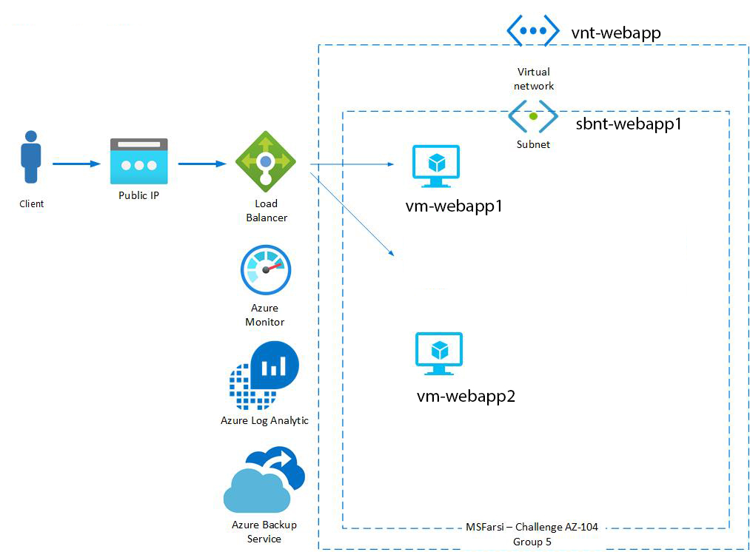
Impalement model

Slide 5
Virtual Machines in Azure​
Features:​
Fully Customizable VM Running desired OS.​
Options for high availability using Availability Sets/Zones
Integration with Azure Backup, Monitoring, and Security tools
Store Application Logs
Main Components
Compute and disk
Software (OS + software/services)

Slide 6
VM vs. Webapp in Azure​
Feature | VM | Web App
Customizability | High - full OS control | Limited
Maintenance | Requires manual attention | Managed by Azure Auto-scaling to handle traffic Integrated with CI/CD
Cost | Pay for compute, storage, and networking | Cost-efficient for web hosting
Use case | Complex applications | Scalable web apps
Estimated Cost | S1 model - $146.00 | DS1 v2 - 142.5 $

Slide 7
Load Balancer
What is Azure Load Balancer​
Scalability
high availability
Types of Load Balancer​
Feature | Basic SKU | Standard SKU
Backend Pool Size | 300 , single avi. set | Up to 5000 instance
Heal probes | tcp, http | tcp, http, https
Availability zone | NA | Zone-redundant
Secure by default | Open internet | Closed inbound except open by NSG
SAL | NA | 99.99%

Slide 8
Load Balancer
Cost of Azure Load Balancer - public
amount of data processed
number of rules used
Hourly charges for public IP addresses
Security Considerations
DDoS Protection
NSG
Private Load Balancer
SSL Termination

Slide 9
Compare Traffic Management model
Feature | Azure LB | Azure Front Door | Azure App Gateway | Azure Traffic Manager
Layer | Layer 4 | Layer 7 | Layer 7 | DNS-based
Traffic Type | Internal & External | External | External | External
Routing Logic | Round-robin, HA for VMs | URL-based routing, SSL offloading | URL-based routing, SSL offloading, WAF | Geolocation, performance-based routing
Use Case | Simple LB for VMs or services | Closed inbound except open by NSG | Web apps with traffic management and security | Global multi-region traffic distribution
Key Feature | Low-latency, highly available load balancing | Application acceleration, SSL offloading, CDN | Web Application Firewall (WAF), SSL termination | Global traffic distribution, failover
Security | NSG, DDoS protection | DDoS Protection, WAF, SSL offloading | WAF, SSL offloading | DNS security features (e.g., CNAME)

Slide 10
Application Backup Strategy for Azure VMs
Overview of Backup Requirements​
Ensure protection for both applications and VMs​
Include VM snapshots, application-level backups, schedule backups​
Easy recovery in case of failure
Backup solution
Azure Backup
Recovery Service Vault

Slide 11
Application Backup Strategy for Azure VMs
Using Recovery Service Vault
Azure virtual machines backup
SQL in Azure VM
Application-level backup (Application-consistent)
Providing VM snapshots
Backup Policy: to define backups schedule and retention range.
Backup Storage redundancy: Geo-redundant / Locally-redundant

Slide 12
Azure Backup Cost
Microsoft Azure Estimate
Service category | Service type | Region | Description | Estimated monthly cost
Management and governance | Azure Backup | Sweden Central | Azure VMs, Standard Backup policy, 2 Instance(s) x 150 GB, LRS Redundancy, Low Average Daily Churn, 321 GB Average monthly backup data in Standard Tier, 0 GB Average monthly backup data in Archive Tier | $28,06

Slide 13
Azure Logging and Monitoring
Key Components of Azure Monitoring​
Azure Monitor
Application Insights
​Log Analytics​

Slide 14
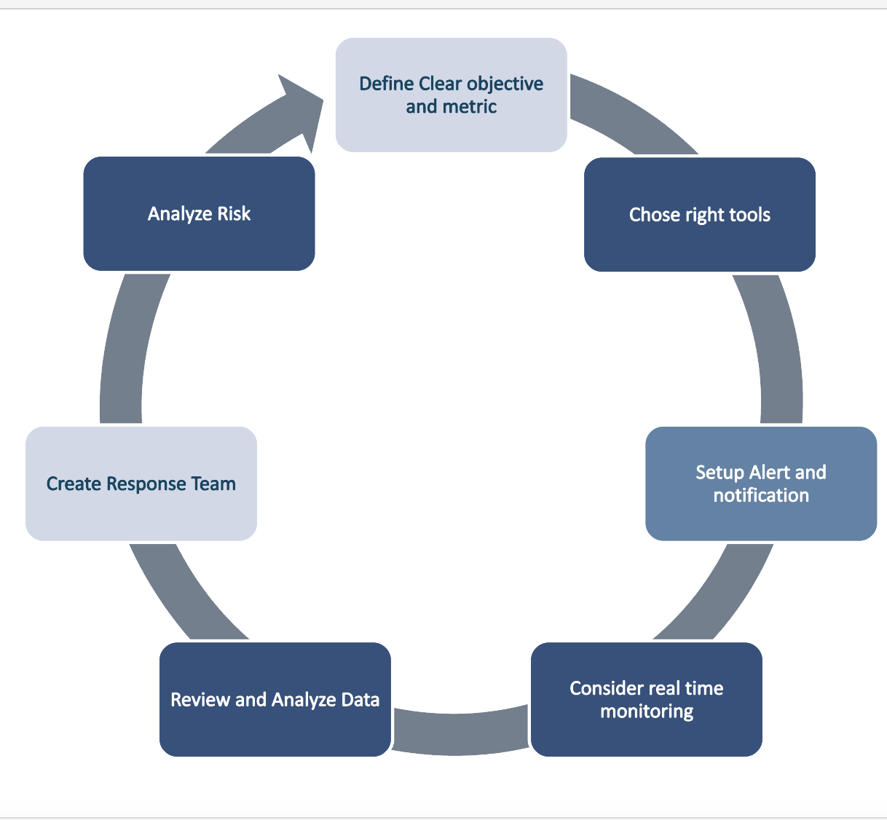
Best Practices for Effective Monitoring​ Monitoring​​
Key Components of Azure Monitoring​
Implementing Alerts and Notifications​
Utilizing Dashboards and Reports​
​Regularly Reviewing Logs and Metrics

Slide 15
Azure Logging and Monitoring Tools
Component
Azure function​
Event Hub​
ITSM
logic app​
Secure Webhook
webhook​
Component
Azure Agent and Extension ​
Azure Data Collection ​
Azure log analytics workspace
workspace​
Component
Metric​
Activity log​
insight

Slide 16
Demo
Code mode
Bicep vs ARM template
param demoParam string = ‘Contoso’
--------------------------
“parameters”: {
“demoParam”: {
“type”: “string”,
“defaultValue”: “Contoso”
}
}

Slide 17
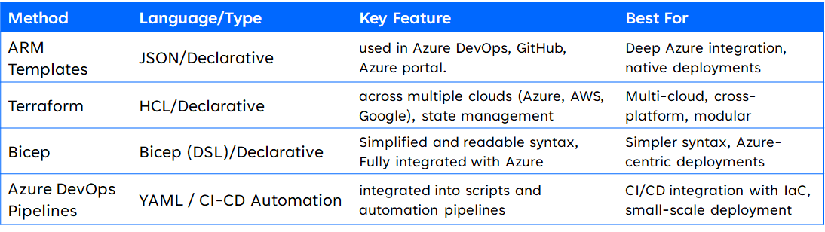
Demo
Bicep vs ARM template

Slide 18
Cost of project
Resource | Number - model | One month
VM | 2 | $142.5
LB | 1 | Public IP + Network throughput
Backup | Backup plan | $28,06
Monitor | basic | Storage acc + agent

Slide 19
Best Practice
VMs deployed in an Availability zone or Availability set for redundancy.
Use containers (use bicep in Azure Devops )
Use webapp for cost management
Backup Storage (Geo Redundant)
Basic tier to standard tier
Auto Tiering for move log to cool to archive
Backup RPO/RTO

Slide 20

Our Team
Mohammad Eshtiaghy​
Mohsen Akbarzadegan​
Nasrin Firoozeh​
Hamed Khaki
Mostafa Mostafavinezhad

Slide 21
Thank you
Questions?

